Slide 1
Web App Demo
Hugo Yung

Slide 2
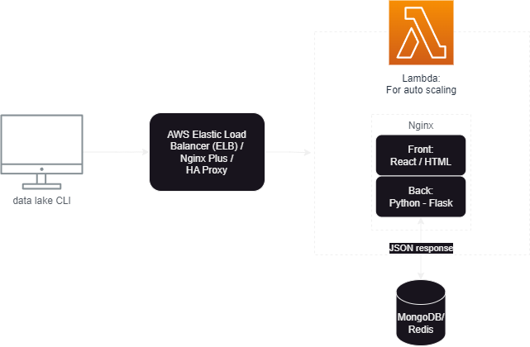
Architecture
Front-end: React
Back-end: Python-Flask
Web server: Nginx
Database: MongoDB / Redis
Traffic Handle:
AWS ELB / Nginx Plus / HA Proxy
Auto Scaling:
AWS Lambda / K8S

